Slide 1

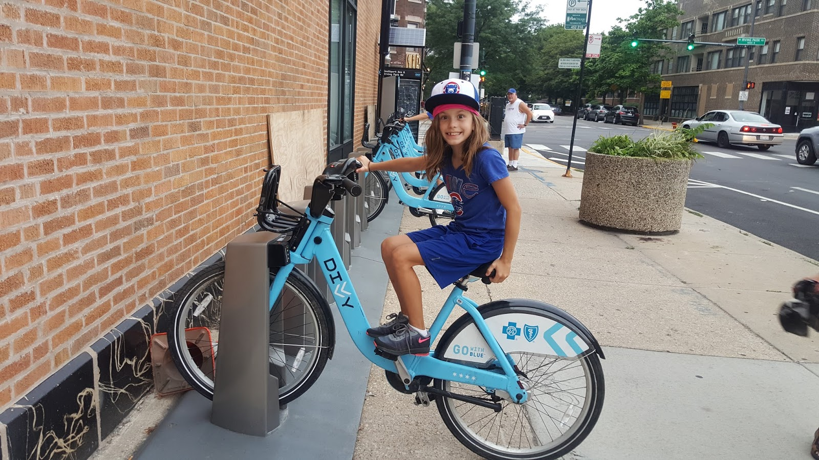
Exploratory Data Analysis on DIVVY Bike Rental Data
Team White

Slide 2

ABSTRACT
In 2016, Divvy launched a successful bike-share offering. Since then, the program has grown to a fleet of 5,824 bicycles that are tracked and locked into a network of 692 stations across Chicago. The bikes can be unlocked from one station and returned to any other station in the system at any time.
Divvy has released its historical system trip data for public usage.
With the historical data, our team will help the company to design a new marketing strategy in order to increase the customer base.
By running exploratory data analysis on the available insights, we can find the trends and strategies to make DIVVY bike rentals stand out of the crowd.
SOURCE : https://divvy-tripdata.s3.amazonaws.com/index.html

Slide 3
DATA ATTRIBUTES
trip_id
rideable_type
started_at
ended_at
start_station_name
start_station_id
end_station_name
end_station_id
start_lat
start_lng
end_lat: string
end_lng: string
usertype: string
tripduration: string
bikeid: string
gender: string
birthyear: string
Start_Hour
Start_Month
Start_Day
Ride_year

Slide 4
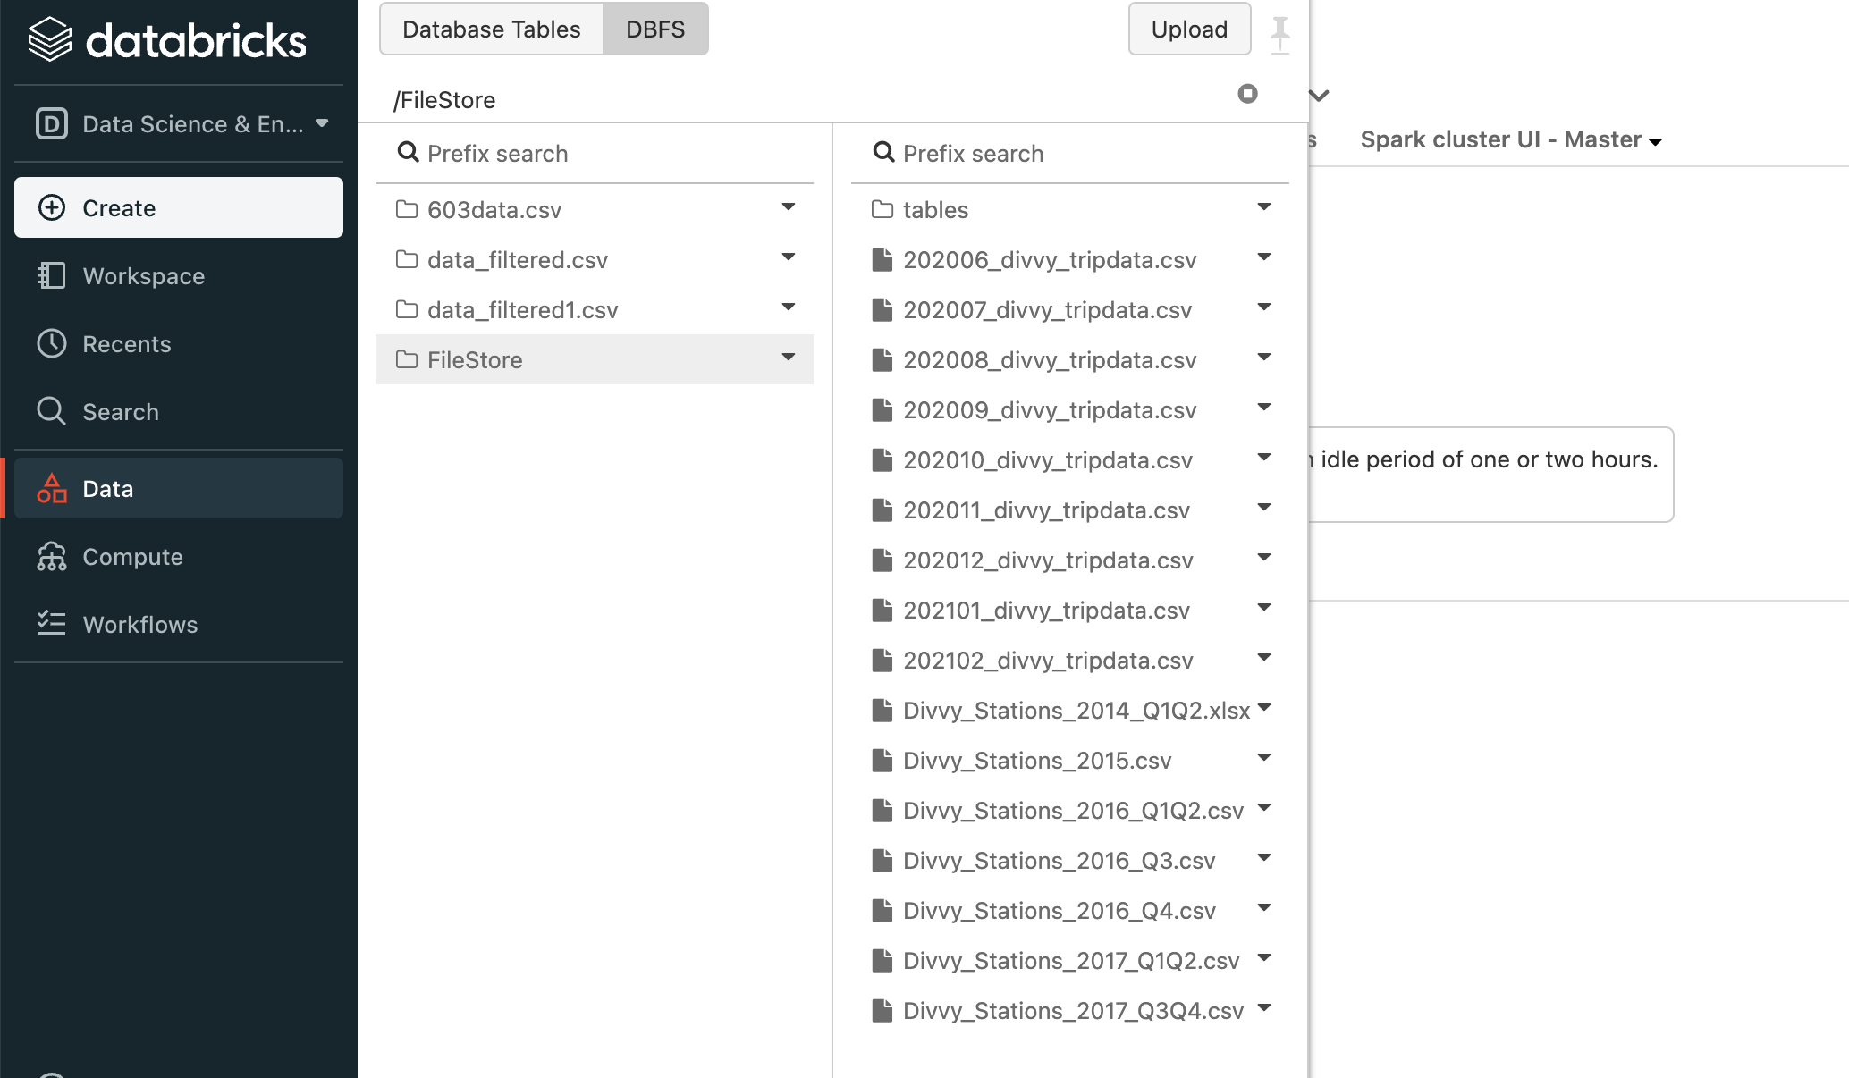
Data Storage

Slide 5
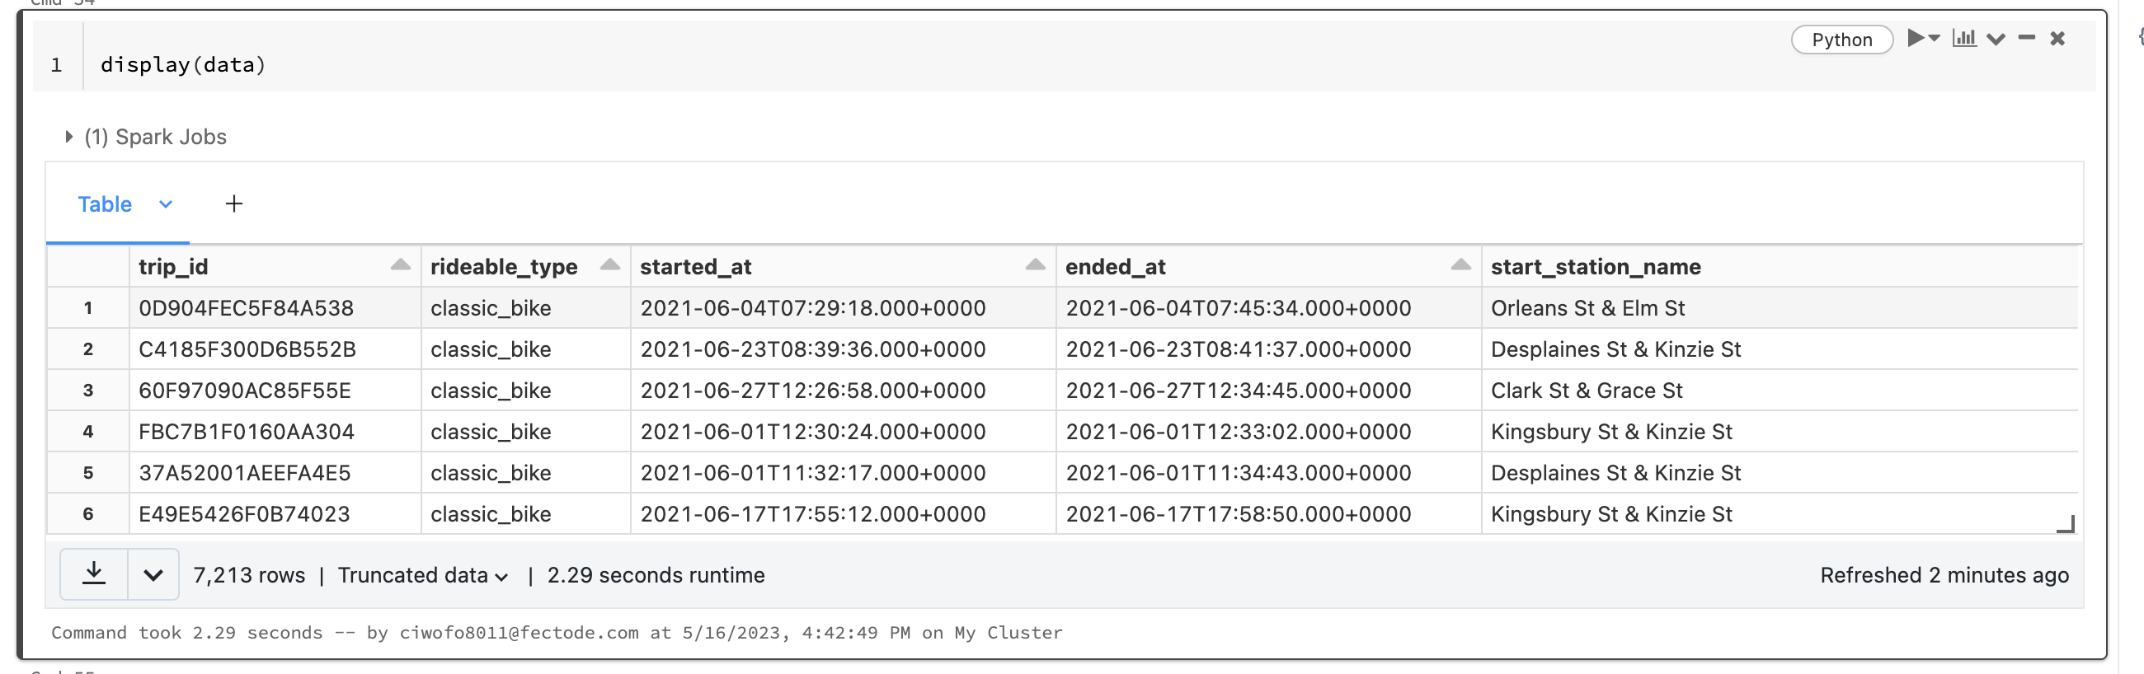
Data Sample

Slide 6
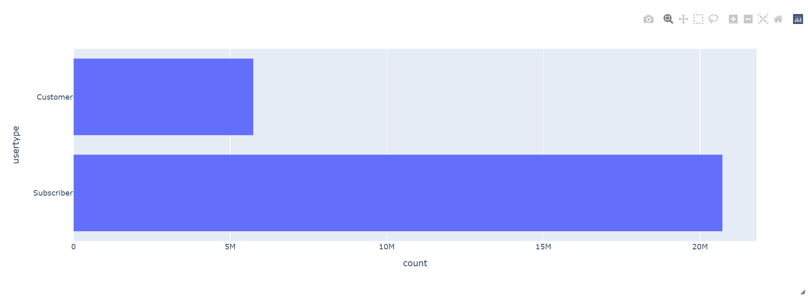
Types Of Customers We have two different types of customers: Floating Customers and Subscribers

Slide 7
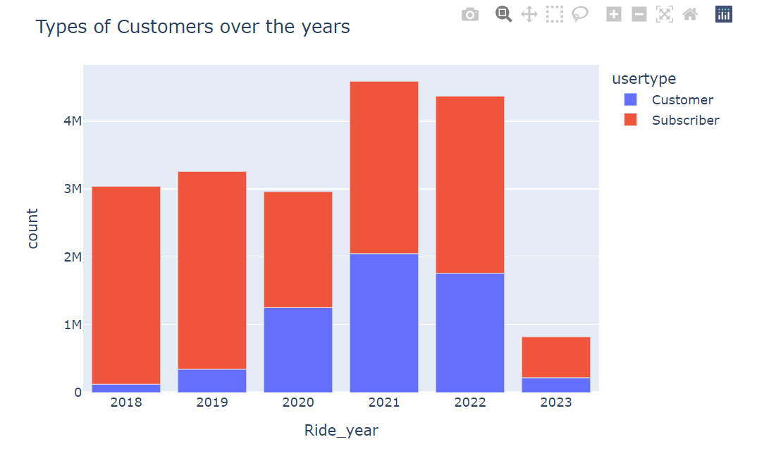
Types Of Customers Over The Years Variation in the type of customers over a period of 6 years

Slide 8
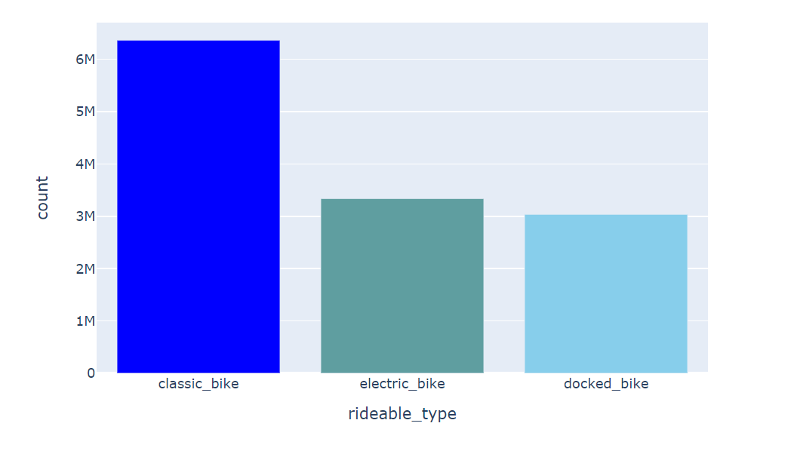
Most Commonly Used Bike Type We Have 3 Different Types Of Bikes: Classic, Electric And Docked

Slide 9
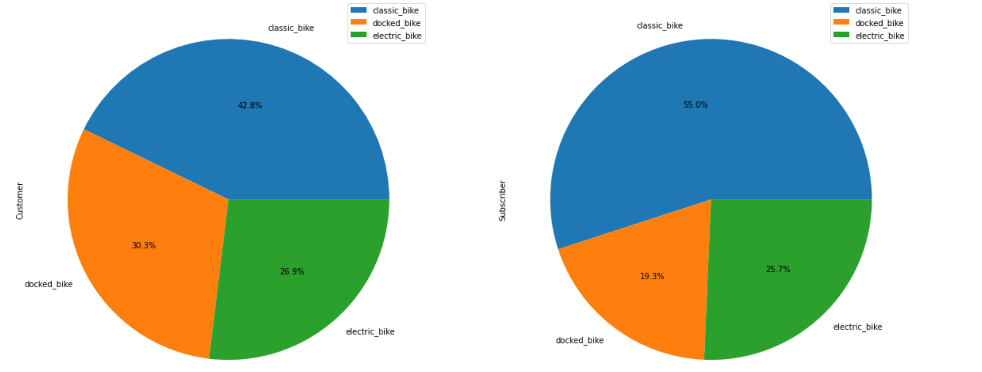
Types Of Bikes Based On Customer Types

Slide 10
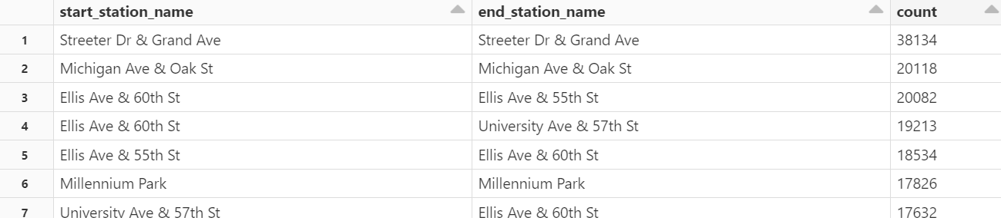
Relation Between Stations

Slide 11
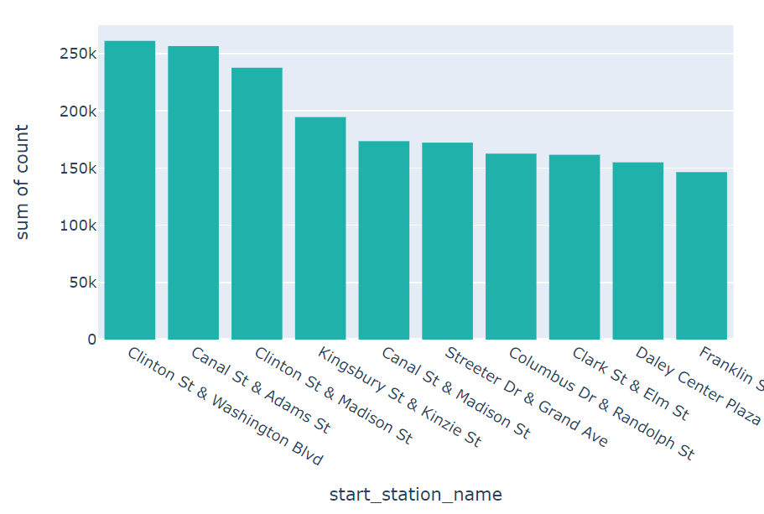
Most Busiest Station

Slide 12
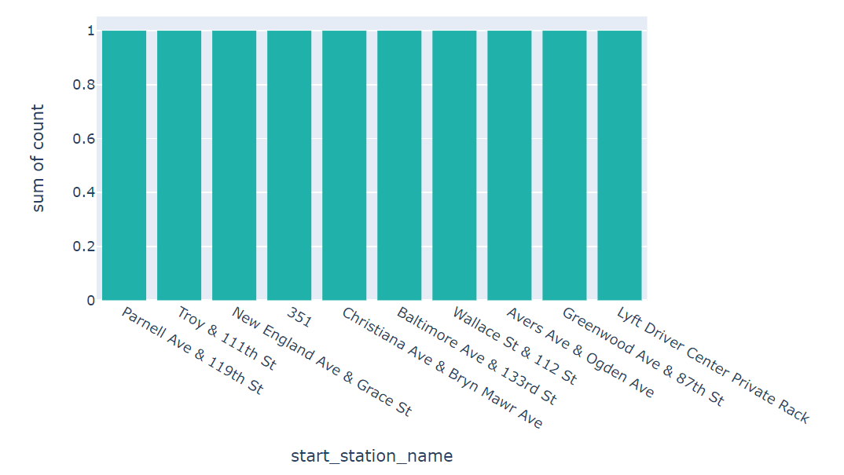
Least Busiest Station

Slide 13
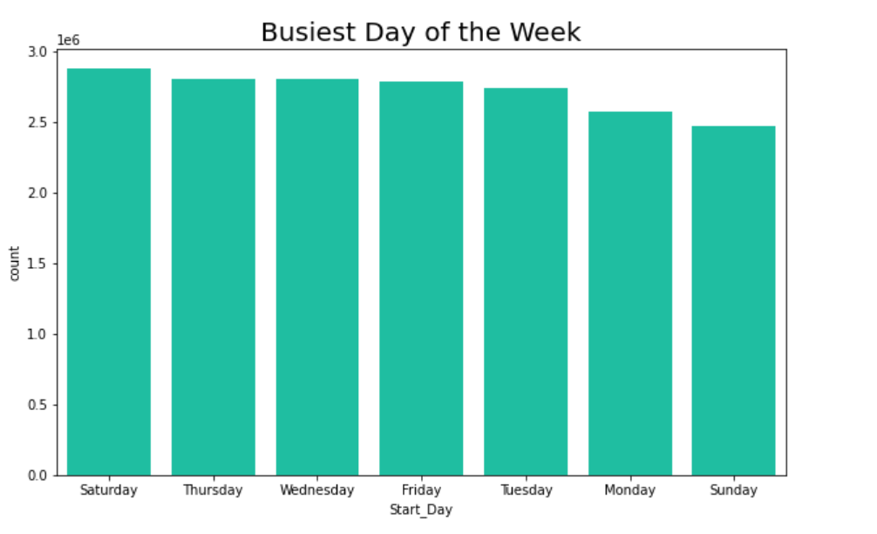
Busiest Days Of The Week

Slide 14
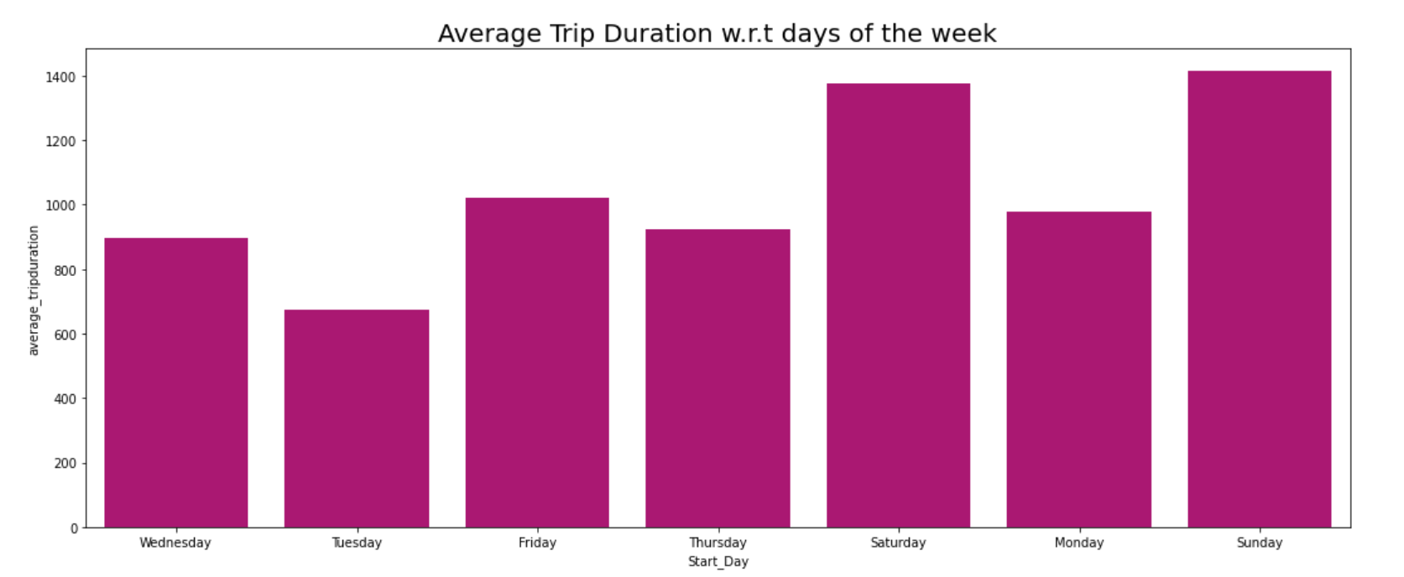
Average Trip Duration W.R.T Days Of The Week

Slide 15
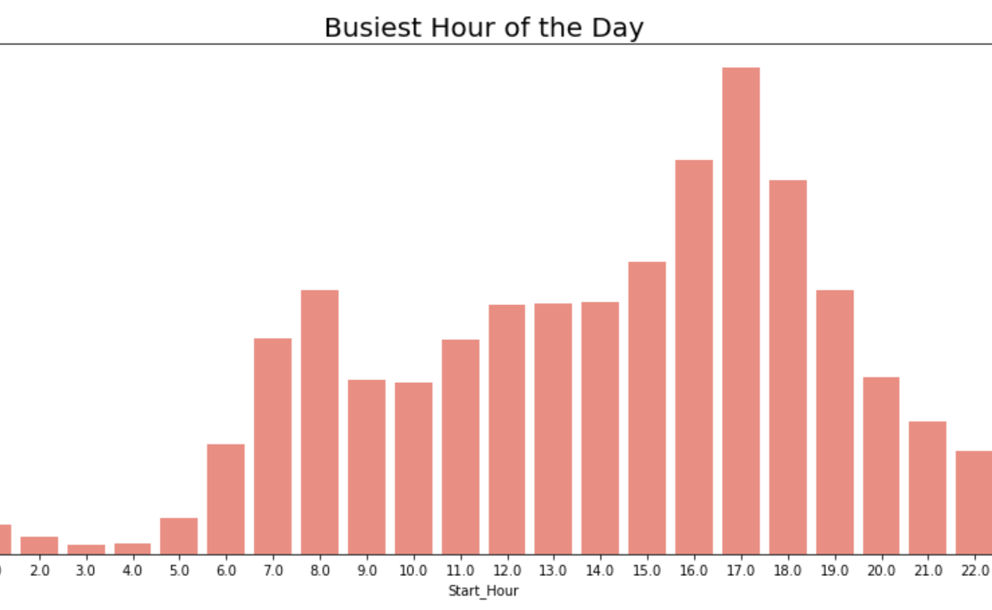
Busiest Hour Of The Day

Slide 16
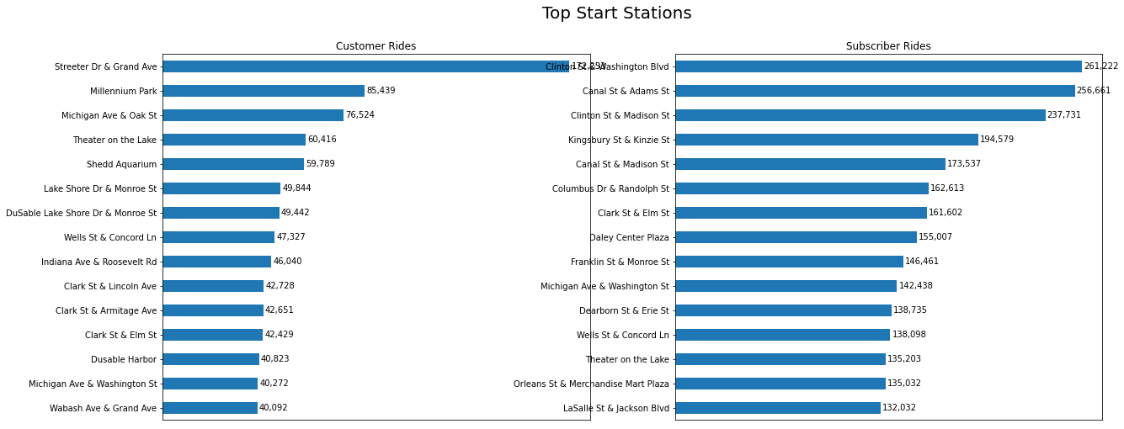
Start Stations with respect to customer type

Slide 17

End Station with respective to customer types

Slide 18
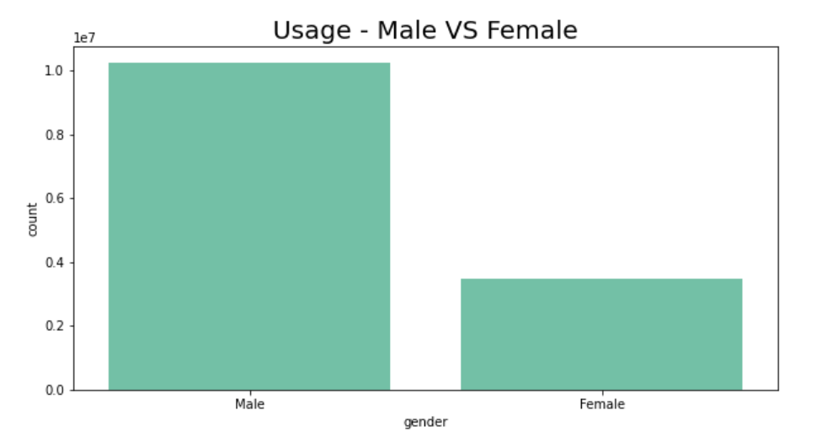
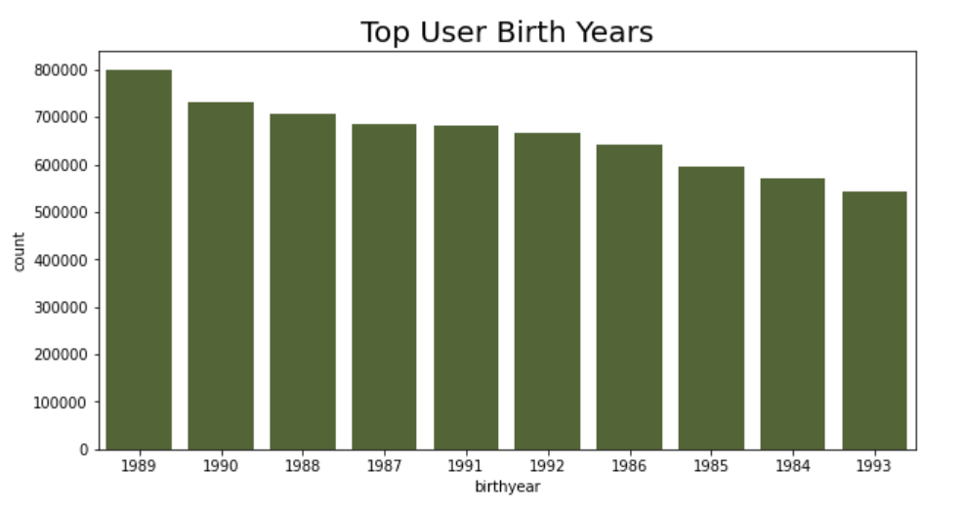
Users On Different Age Groups
Usage comparison with respect to gender

Slide 19
Recommendations
Improve
Improve infrastructure: Identify stations with high ride demand and ensure adequate bike availability, docking spaces, and maintenance at those locations.
Target
Target marketing efforts: Develop targeted marketing campaigns to encourage casual customers to become subscribers. Highlight the benefits of membership, such as cost savings or access to exclusive features.
Expand
Expand service: Explore opportunities to expand the bike-sharing service to new areas or communities, considering the popularity of certain stations and user preferences.
Notes:
Improve
Improve infrastructure: Identify stations with high ride demand and ensure adequate bike availability, docking spaces, and maintenance at those locations.
Target
Target marketing efforts: Develop targeted marketing campaigns to encourage casual customers to become subscribers. Highlight the benefits of membership, such as cost savings or access to exclusive features.
Optimize
Optimize operations: Analyze ride patterns by day of the week to allocate resources effectively. Adjust bike availability and staffing levels based on peak demand days or hours.
Enhance
Enhance user experience: Monitor trip durations to identify potential bottlenecks or issues affecting user experience. Address any infrastructure limitations or areas with longer-than-average trip durations.
Expand
Expand service: Explore opportunities to expand the bike-sharing service to new areas or communities, considering the popularity of certain stations and user preferences.

Slide 20
Thankyou
Sowmith Kola
Pragna Pulipati
Naga Praneeth Madasu

